Slide 1

Chapter 2
The theory of Demand
and Supply in a Perfectly Competitive Market

Slide 2
2.1. Overview of Market Structure
In this course we focus on free market economic system
In a free market economic system resources are allocated through price (market) mechanism
Four types of market structure are there
Perfectly competitive market
Pure Monopoly market
Monopolistic competition
Oligopoly
Imperfect markets

Slide 3
2.2. The Theory of Demand
Definition
Demand is different quantities that a consumer is willing and able to buy at various prices other things remaining constant
A demand can be shown using
A demand schedule
A demand curve and
A demand function
Hypothetical example
Assume Mr. X has a budget of 120 birr per month from his income to consume Orange

Slide 4
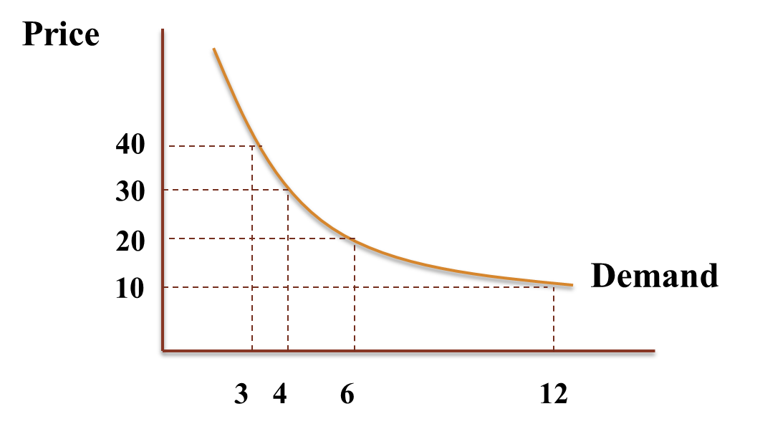
Demand Schedule
Demand Curve
Price of a Kg. of Orange | Quantity Demanded
10 | 12
20 | 6
30 | 4
40 | 3
Quantity Demanded

Slide 5
Demand function
direct demand function
inverse demand function
The law of Demand : the law states that quantity demanded and price are inversely related, other things remaining constant.

Slide 6
Special Demand Curves
1) Giffen Goods
Giffen goods are goods that are demanded more when their price rises because consumers think they are good quality if their prices rise
7
DD
P
6
5
4
3
2
1
0
7
14
Qd

Slide 7
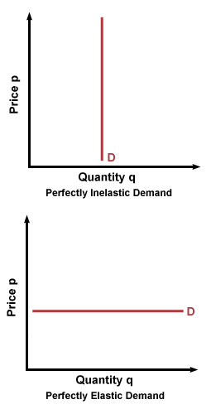
2) Perfectly Elastic Demand Curve
Any quantity is purchased at a given price
Example: demand that faces a perfectly competitive firm

Slide 8
3) Perfectly Inelastic Demand Curve
Consumers buy a fixed quantity at different prices
Example: theatre entrance fee for children and adults

Slide 9
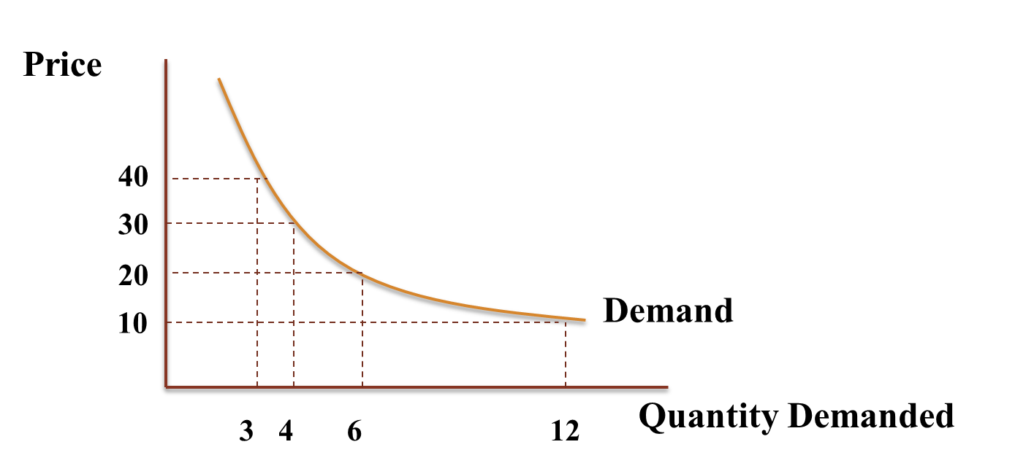
Change in Quantity Demanded and
Change in Demand
Change in Quantity demanded
▲Qd is caused by change in price of the product
It is represented by movement along the same curve

Slide 10
Change in Demand:
▲DD is caused by change in other determinants other than price of the product
Represented by shift in demand curve
Income of a consumer
Price of related goods
Taste/preference
Expected price
Expected income
Government income tax
Number of buyers, etc.

Slide 11
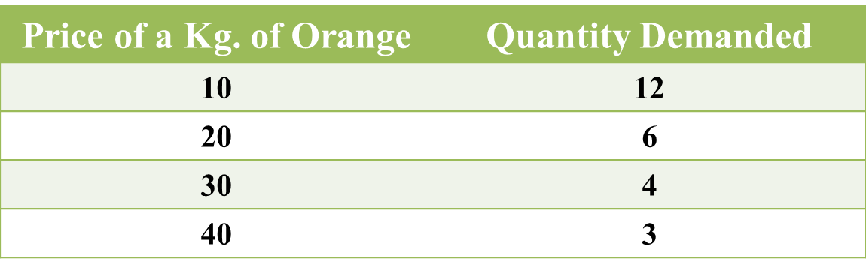
A) Effect of change in income
If income of a consumer changes its effect depends on the nature of the product
Luxury
Necessity
Inferior good →inverse relation
Example: Assume Mr. X has a budget of 120 birr per month from his income to consume Orange
Normal good→ direct relation

Slide 12
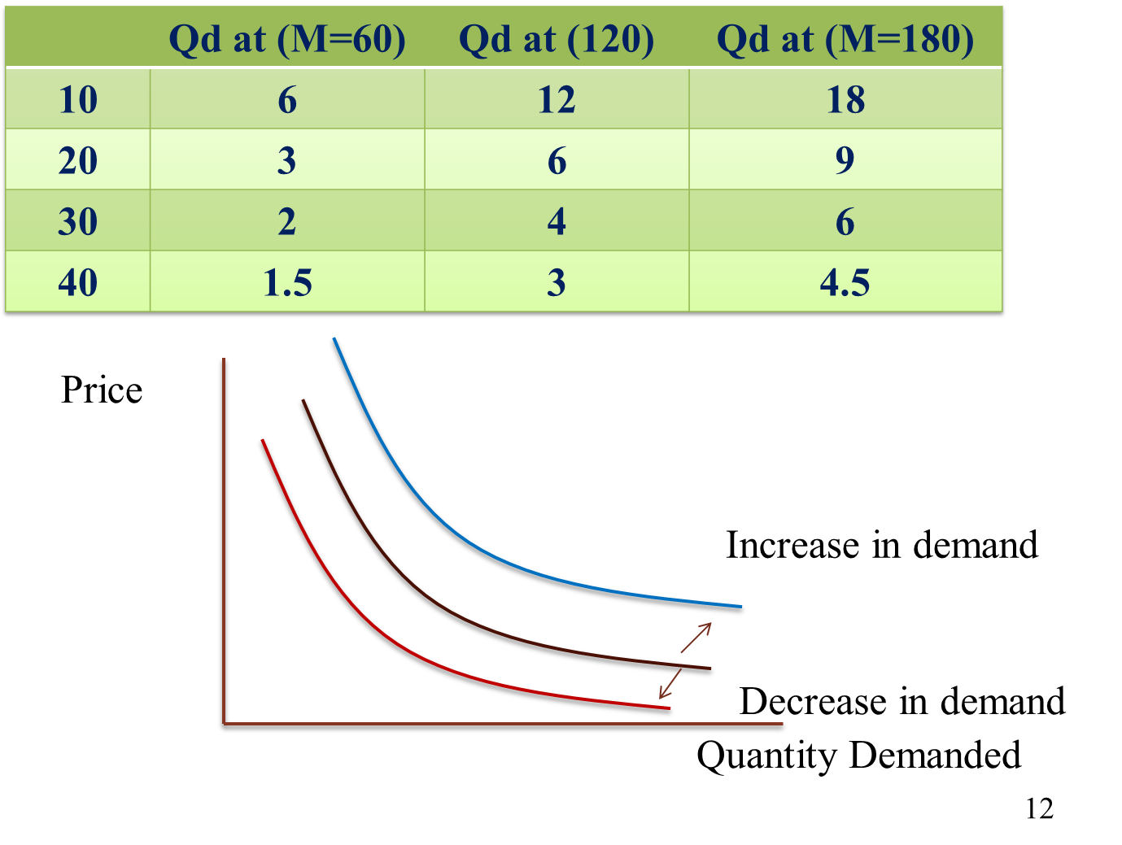
Now if income decreases to 60 and increases to 180 birr per month what are the demands?

Slide 13
B) Effect of change in Price of related goods
Products are related in two ways
Substitute
Complimentary
Increase in price of a substitute increases demand of the other
Eg. Price of pepsi → demand of coca-cola
Increase in price of a complimentary decreases demand of the other
Eg. Price of white board → demand of marker
Increase in dd is shift of the dd curve to the right
Decrease in dd is shift of the dd curve to the left

Slide 14
C) Taste/preference
Good taste increases demand
Bad taste decreases demand
D) Expected price
Expectation of high future price increases current demand
Expectation of lower future price decreases current demand
E) Expected income
Expectation of high future income increases current demand for normal goods
For inferior goods the opposite is true
F) Government income tax: affects demand through income
G) Number of buyers in the market: large number increases demand

Slide 15
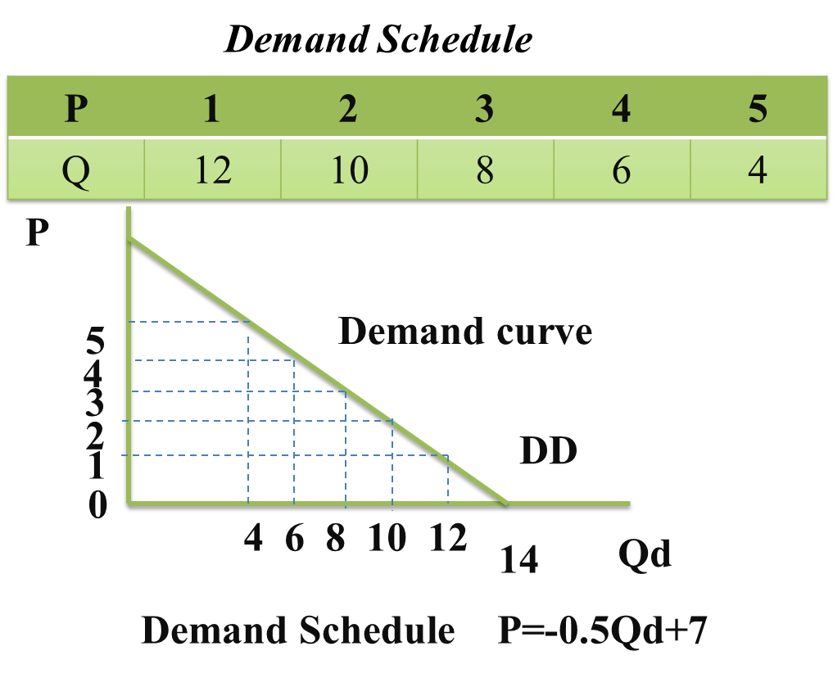
For further mathematical treatment, we usually use linear demand function
As long as the law of demand is kept, the linear demand doesn’t create problem

Slide 16
Individual and Market Demand
Market demand is derived from individual demand
P | Qd1 | Qd2 | Qd3 | Qdm
10 | 6 | 12 | 18 | 36
20 | 5 | 10 | 15 | 30
30 | 4 | 8 | 12 | 24
40 | 3 | 6 | 9 | 18
20
20
20
20
5
10
15
30

Slide 17
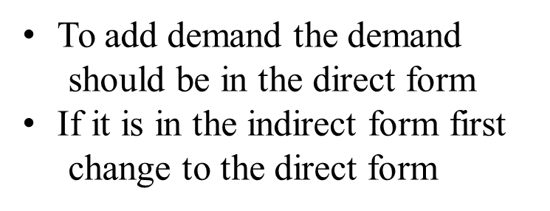
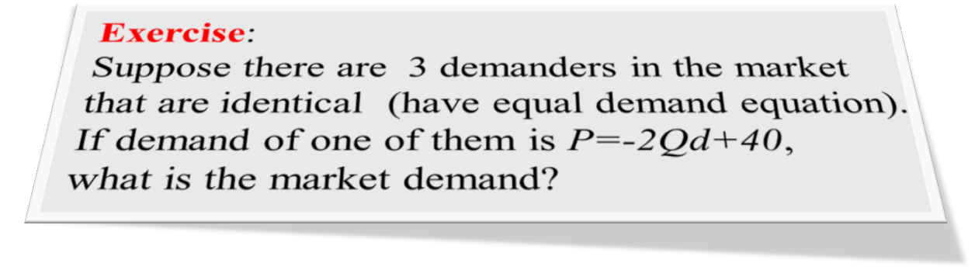
Mathematically using the direct demand function
.

Slide 18
2.3. The Theory of Supply
Definition
Supply is different quantities a producer is willing and able to produce at various prices, other things remaining constant
Supply can be shown by
Supply schedule
Supply curve
Supply equation
Other things remaining constant increase in prices leads to more profit
Firms increase supply as price increases

Slide 19
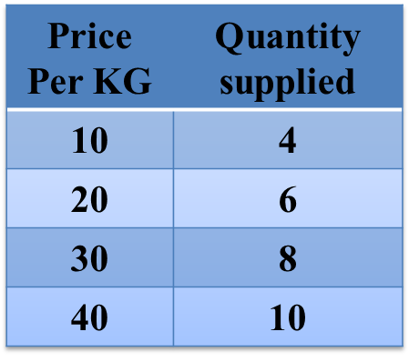
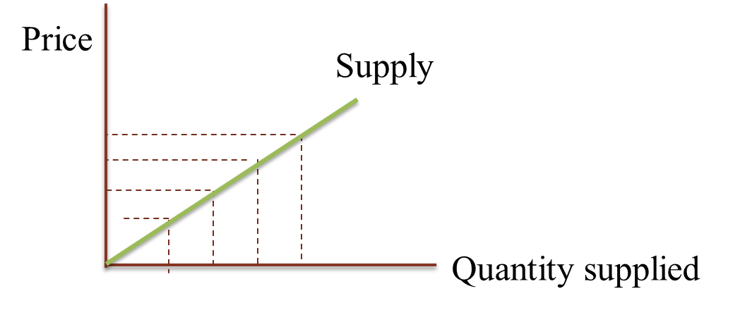
Hypothetical example: Supply of Orange
Supply schedule
Direct Supply equation Qs=2P+2
Inverse supply equation P=1/2Qs-1
The Law of supply:
It states that price and Qs are directly related
Supply Curve

Slide 20
Change in Quantity Supplied and
Change in Supply
Change in Quantity Supplied
It is caused by change in price of the product
It is represented by movement along the same curve
.
Price
Supply
40
30
20
10
Quantity supplied
5
10
15
20

Slide 21
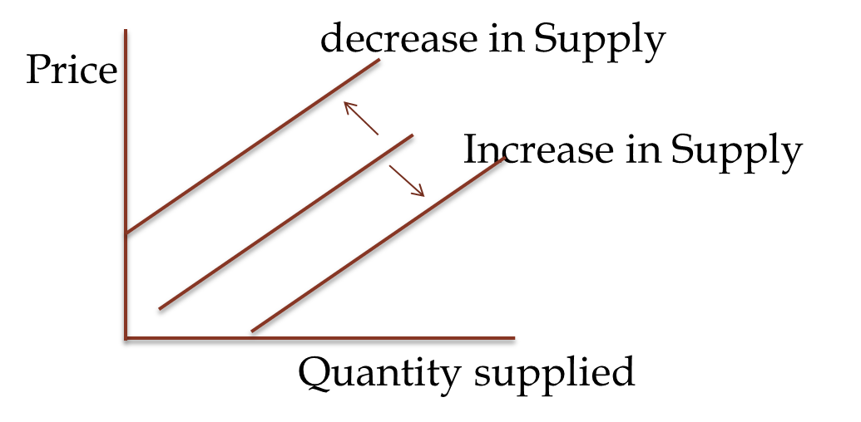
Change in Supply
It is caused by other factors other than price of the product
It is represented by shift in supply curve
The determinants include
cost of inputs
Price of related good
Change in technology
Business Tax and subsidy
Producers expected price
Weather conditions
Number of sellers in the market etc.

Slide 22
Costs of input: higher costs decrease supply
Price of related good:
Substitute: in P of white teff → ss of red teff
Complimentary: P of black board → SS of chalk
Improvement in technology increases supply
Business tax decreases supply
Subsidy increases supply
High expected future price decreases current supply
Bad weather condition decreases supply
Number of sellers: large number of sellers increases market supply etc.

Slide 23
Individual Supply and Market supply
The market supply is derived in similar fashion with the market demand
Example: Assume there are only two suppliers of meat
Price of Meat/Kg in birr | Quantity Supplied of Butcher A | Quantity Supplied of Butcher B | Marker Meat supply
200 | 100 | 100 | 200
250 | 200 | 140 | 340
300 | 300 | 180 | 480
350 | 400 | 220 | 620
400 | 500 | 260 | 760

Slide 24
P
SS
P
SS
P
SS
300
200
Qs
Qs
200
480
Qs
100
300
100
180
Mathematically: assume there are only two suppliers with supply functions given below. What is the market supply

Slide 25
Exercise
1) Assume there are 100 identical suppliers of a certain product in the market. If the direct supply equation of one is QS=P-20, what is the market supply function?
2) Assume there are 100 identical suppliers of a certain product in the market. If the inverse supply equation of one is P=20+Qs, what is the market supply function?

Slide 26
2.3. Market Equilibrium
Market equilibrium is where DD=SS
At equilibrium no shortage no surplus
If DD≠SS, price adjusts it self to equate them
Hypothetical example of red teff market per month
Price per Quintal | Quantity Supplied (Qs) (In million quintal ) | Quantity Demanded (Qd) (In million quintal ) | Shortage (-) Surplus (+) (In million quintal ) | Pressure on Price
4,000 | 6 | 12 | -6 | Price rises
4,500 | 7 | 10 | -3
5,000 | 8 | 8 | 0 | Equilibrium
5,500 | 9 | 6 | 3 | Price falls
6,000 | 10 | 4 | 6

Slide 27
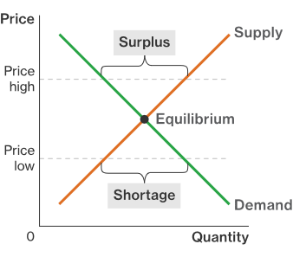
For all prices higher than equilibrium →Surplus
For all prices lower than equilibrium →Shortage
P*
Q*

Slide 28

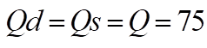
Mathematically:
Suppose the market demand and supply of a commodity is given by the following equations
A) find equilibrium P and Q
B) find surplus if P=10
C) Find shortage if P=1
A) At equilibrium
Substituting

Slide 29
B) surplus is
C) shortage is

Slide 30
Change in Equilibrium Price and Quantity
Change in market DD, SS or both affects equilibrium Price and quantity
A) Only Demand shifts
Demand → P* and Q*
Demand →P* and Q*
SS₁
P
P*
DD₂
DD₀
DD₁
Q*
Q

Slide 31

B) only supply shifts
Supply → P* and Q*
Supply →P* and Q*
SS₀
SS₁
P
SS₂
P*
DD₁
Q*
Q

Slide 32
C) Both demand and supply change
C1) Both demand and supply increase
Demand → P* and Q*
Supply → P* and Q*
------------------------------------------
Net effect P* indeterminate and Q*
C2) Both demand and Supply decrease
Demand → P* and Q*
Supply → P* and Q*
----------------------------------------
Net effect P* indeterminate and Q*

Slide 33
C3) Demand increases and supply decreases
Demand → P* and Q*
Supply → P* and Q*
------------------------------------------
Net effect P* and Q* indeterminate
C4) Demand decreases and Supply increase
Demand → P* and Q*
Supply → P* and Q*
----------------------------------------
Net effect P* and Q* indeterminate

Slide 34
Price Floor
Price floor is a minimum price level set by government
It is set above equilibrium price
Selling below this price is illegal
Charging higher price is legal
It is to support producers with higher price
For all prices higher than price floor there is no demand
So demand is constant at the price floor
This Creates surplus and black market
Products are hiddenly sold at lower price

Slide 35
2.4. Elasticity of Demand and Supply
Elasticity is the degree of responsiveness of one economic variable due to change in other economic variable, ceteris paribus
2.4.1. Elasticity of Demand
I. Price Elasticity of Demand (Ɛp)
Price elasticity (own price elasticity) of demand is a measurement of the responsiveness of demand for the change in the commodities own price, ceteris paribus.

Slide 36
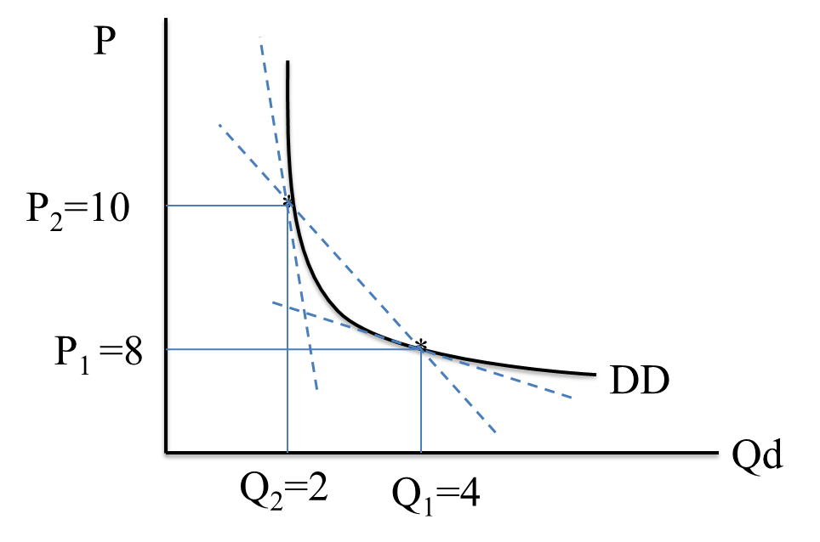
Point percentage
Average percentage

Slide 39

i) Point elasticity of demand:-
Is used to measure price elasticity of demand when the change in price is very small or at a point.
It uses the original number as base (100%)
Where is the slope of direct demand function or
is the reciprocal slope of inverse demand
function

Slide 40
Example 1:
If increase in P from 2 to 4 decreases Qd from 10 to 8, what is Ɛp?
Interpretation: a 1% increase in P leads to a 0.2% decrease in Qd, ceteris paribus.
Example 2:
If decrease in price by 20% increases Qd by 40% then what is the Ɛp?
Interpretation: A 1% decrease in P leads to a 2%
increase in Qd, ceteris paribus.

Slide 41
Example 3:
Suppose a direct demand function of a product is Qd=20-2P, what is Ɛp at P=5
Solution:
Interpretation: A 1% change in P leads to a 1%
change in Qd, ceteris paribus

Slide 42
Exercise
Consider the following market demand and supply equation P = 20-0.5 Qd and P = 16+0.5Qs
What is the price elasticity of demand at the equilibrium point and interpret the result!
ii) Arc Elasticity of Demand
is used when the change in price is relatively large
it measures elasticity between two points
it uses the average of before and after change as base (100%)

Slide 43
Example:
Due to the rise in Price of sugar from 20 to 30 birr per Kg, if market quantity demanded falls from 16 million Kgs to 14 million Kgs of sugar. What is the arc price elasticity of demand?
Interpretation: on average, a 1% rise in price of sugar leads to a 0.33% decline in the Qd, ceteris paribus
Exercise
Suppose a demand function is P=20-Qd. If price changes from 5 to 10, what is the arc price elasticity
of demand?

Slide 44
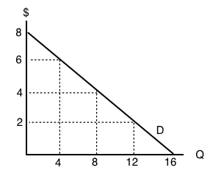
Degrees of elasticity
If Ɛ_{P} = ∞ perfectly elastic
If Ɛ_{P} > 1 elastic
If Ɛ_{P} = 1 unitary elastic
If 0<Ɛ_{P}< 1 inelastic
ƐP = 0 perfectly inelastic
Perfectly elastic demand
Elastic
Unitary Elastic
Inelastic

Slide 45
Price | Quantity Demanded | Point Price elasticity of demand
7 | 1 | 7
6 | 2 | 3
5 | 3 | 5/3
4 | 4 | 1
3 | 5 | 3/5
2 | 6 | 1/3
1 | 7 | 1/7

Slide 46
Determinants of Price Elasticity of Demand
The existence of similar or substitute good makes more elastic
Nature of the good
Necessity products are inelastic
Luxury products are more elastic
The percentage that commodity represents in a consumer total budget
Low percentage → inelastic eg. needle
High percentage → elastic eg. car
The length of time allowed (available) to adjust to change in price
In the short run → inelastic
In the long run → elastic

Slide 47

III. Income Elasticity of Demand
Ɛ_{I} measures the responsiveness of demand for the change in consumer’s income, ceteris paribus
Point income
elasticity of Demand
ii) Arc income
elasticity of Demand

Slide 48
Nature of product
If Ɛ_{I} > 1, luxury good
If 0<Ɛ_{I} < 1, necessity good
If Ɛ_{I} < 0, inferior good
Exercise: if due to increase in income of a consumer from 10,000 to 12,000 birr per month, Qd increases from 500 to 1,000 per month
A) what is the point Ɛ_{I}?
B) Interpret the result?
C) what is the nature of the good?
D)what is the arc Ɛ_{I}?
E) Interpret the result?
Normal good

Slide 49

II. Cross Price Elasticity of Demand
Ɛ_{AB -} measures responsiveness of demand for the change in the price of related goods, ceteris paribus
ii) Arc Cross Price
Elasticity of Demand
i) Point Cross Price
Elasticity of Demand

Slide 50
Nature of relation
If Ɛ_{AB} >0 the goods (A and B) are substitute
If Ɛ_{AB} =0 the goods (A and B) are unrelated
If Ɛ_{AB} <0 the goods (A and B) are complimentary
Exercise
Suppose that Price of good B increased from 8 to 10, and Qd of good A decreased from 1,200 to 1,000 per month.
A) find the point Ɛ_{AB}?
B) determine the nature of relation
C) interpret the result
D) find the arc Ɛ_{AB}?
E) interpret the result

Slide 51
2.4.2. Price Elasticity of Supply
Ɛ_{S} is the measurement of responsiveness of quantity supplied when price changes, ceteris paribus
Arc price
Elasticity of Supply
Point price
Elasticity of Supply

Slide 52
Degrees of elasticity
If Ɛ_{P} = ∞ perfectly elastic
If Ɛ_{P} > 1 elastic
If Ɛ_{P} = 1 unitary elastic
If 0<Ɛ_{P}< 1 in elastic
ƐP = 0 perfectly inelastic
Determinants of Price Elasticity of Supply
Length of time available for adjustment
In the short-run →supply is in inelastic
In the long run → supply is elastic
If factors of production are available, SS is elastic
Ability to store output
Perishable products – inelastic supply
Storable products – elastic

Slide 53
Factor mobility
Restricted mobility of factor – supply inelastic
Free mobility of factor – supply elastic
Change in cost of production with increase in output
If cost is increasing – supply is inelastic
If cost is not increasing – supply is elastic
Excess supply capacity
If the company can easily produce more – supply elastic
If it has no excess capacity – supply is inelastic
Availability of infrastructure facilities
Good infrastructure facility – elastic supply
Poor infrastructure facility – supply inelastic
Weather condition
If it depend on weather condition – supply is in elastic Example: Agricultural products

Slide 54


